Slide 1
Application of Whole Genome Sequencing to Research Questions
May 29-30, 2024
Stephanie Felker
Postdoctoral Trainee
UAB-HudsonAlpha Genomic Medicine PostDoctoral Training Program
Greg Barsh Laboratory - HudsonAlpha

Slide 2
My Background
Huntsville Native: Huntsville High School Class of 2005
Education - All UAH
Bachelors: Double Majored in Biology and Chemistry (2010)
Masters: Chemistry (2012)
Organic Synthesis, Natural Products Chemistry, Molecular Modeling
PhD: Biotechnology (2023)
Alternative splicing, neurodevelopmental disorders, bioinformatics

Slide 3

My Background
Professional Background
During Undergrad: cardiac monitoring at Huntsville Hospital
Clinical Research Trial Coordinator: 2010-2012
Pharmaceutical Chemist at Qualitest/Par/Endo Pharmaceuticals: 2013-2018
Current Position: Postdoctoral Trainee in the Greg Barsh lab through UAB and HudsonAlpha

Slide 4
Research Overview
Aim: Identify social and biological factors that influence the diagnosis of neurofibromatosis type 1 (NF1) within the All of Us Research Program (AoURP)
Social Determinants of Health (SDoH): elements outside of genetic or medical conditions such as race, income, geography, and education
SDoH account for up to 47% of overall health outcomes in patients within the United States

Slide 5
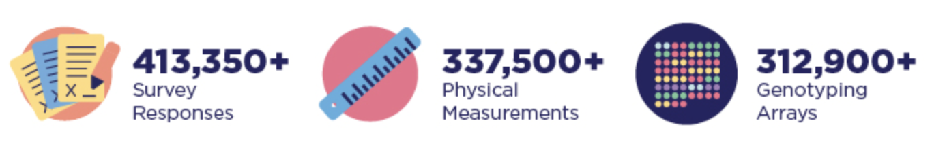


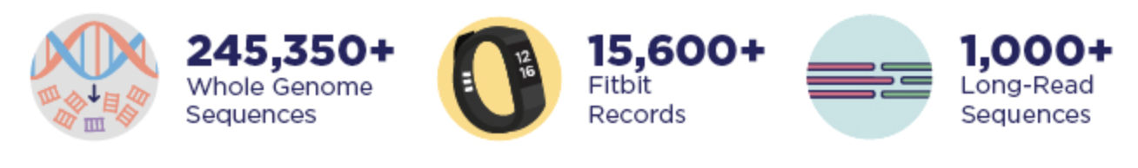
The All of Us Research Program
180,497 All of Us participants
https://allofus.nih.gov/get-involved/opportunities-researchers

Slide 6
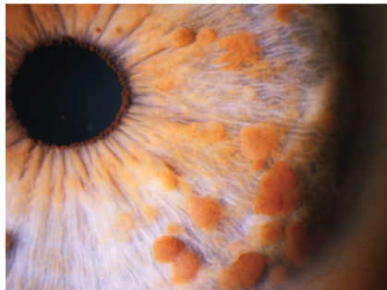
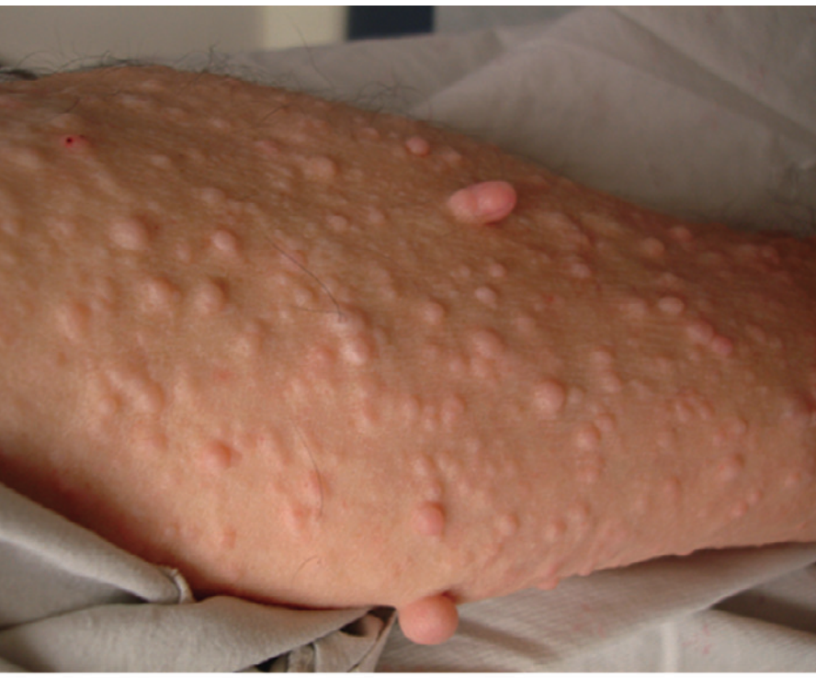
Neurofibromatosis Type 1
Caused by pathogenic variation in NF1 (neurofibromin)
Affects 1/3000 individuals
Autosomal dominant
50% of cases are caused by de novo mutations
No increased prevalence in any genetic ancestry or sex
Anderson JL, Gutmann DH. Neurofibromatosis type 1. Handbook of Clinical Neurology. 2015;132:75-86. PMID: 26564071.

Slide 7
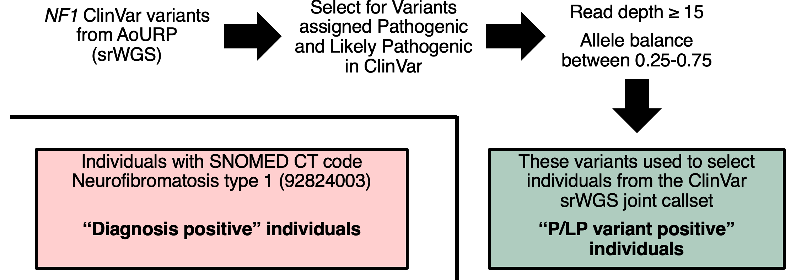
Methodology

Slide 8
Overview
We found 49% of individuals with pathogenic or likely pathogenic (P/LP) NF1 variants do not have an NF1 diagnosis
Are the EHR of undiagnosed individuals incomplete?
Are there SDoH differences between diagnosed individuals and undiagnosed individuals?
Do variants in diagnosed individuals have a higher biological impact?

Slide 9
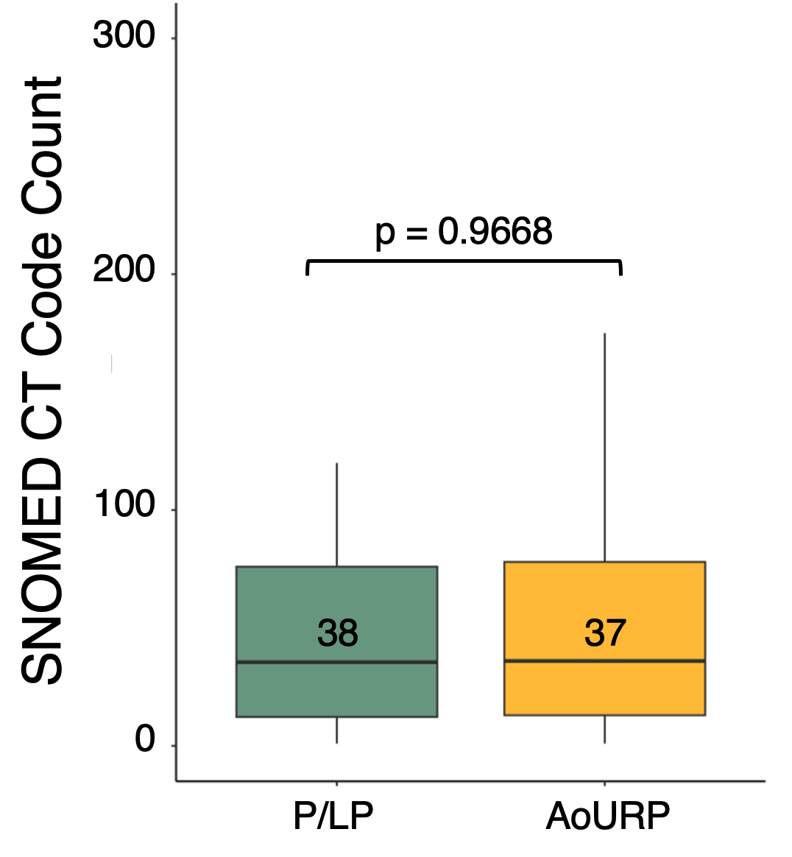
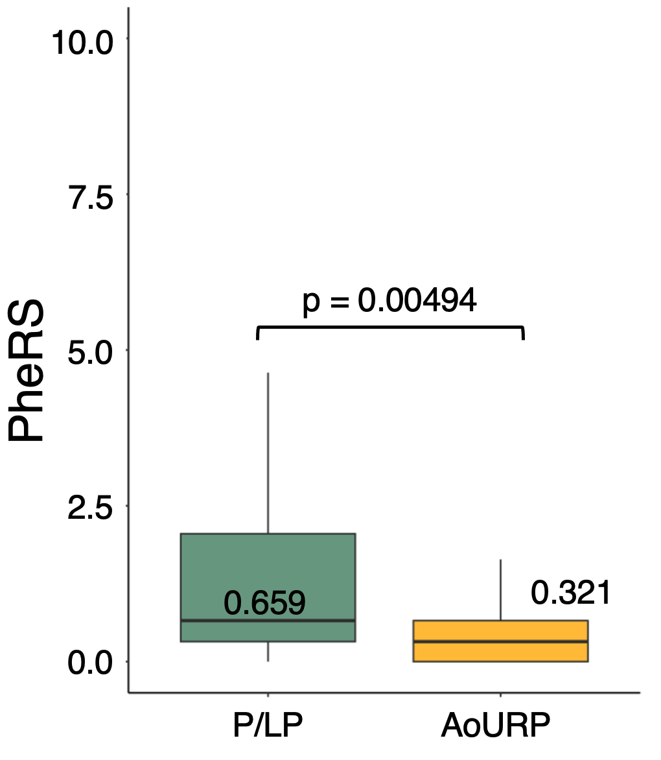
Are the EHR of undiagnosed individuals incomplete?
EHR Completeness
NF1 Phenotype

Slide 10
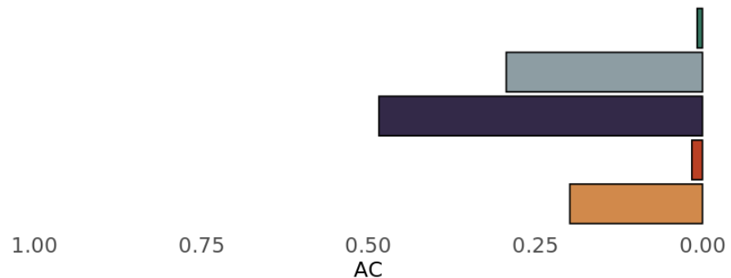
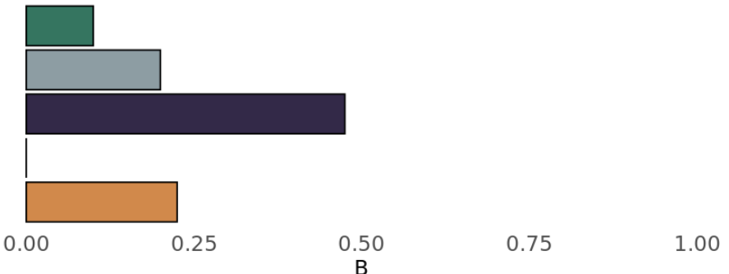
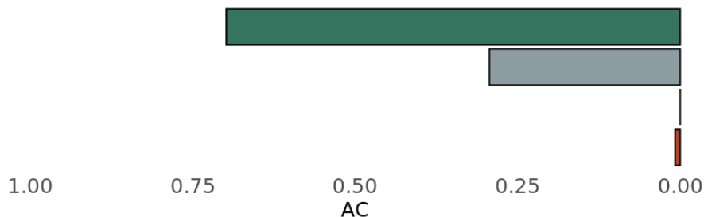
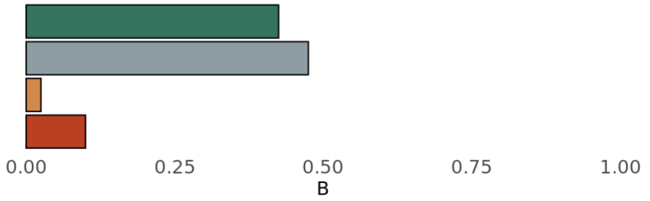
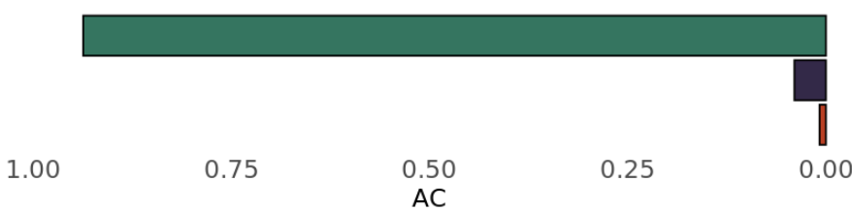
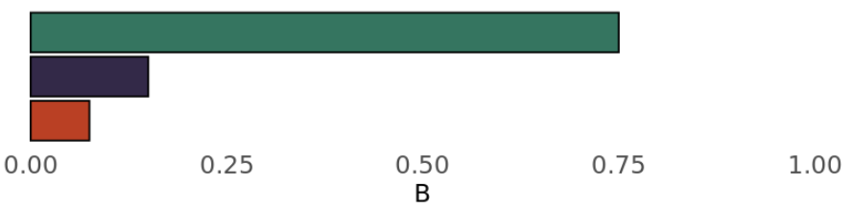
Are there SDoH differences between diagnosed and undiagnosed individuals?
Self-Reported Race (p = 0.02863)
0.8%
Asian
10.0%
29.4%
Black or AA
20.0%
48.4%
White
47.5%
1.6%
0.0%
Multiple
Diagnosed with NF1
19.8%
NS
22.5%
P/LP NF1 Variation without an NF1 Diagnosis
Gender (p = 0.005867)
69.8%
Female
42.5%
29.4%
Male
47.5%
0%
2.5%
Other
0.8%
7.5%
NS
Health Insurance (p = 0.01754)
Yes
76.9%
95.2%
No
15.4%
4.0%
0.8%
7.7%
NS

Slide 11
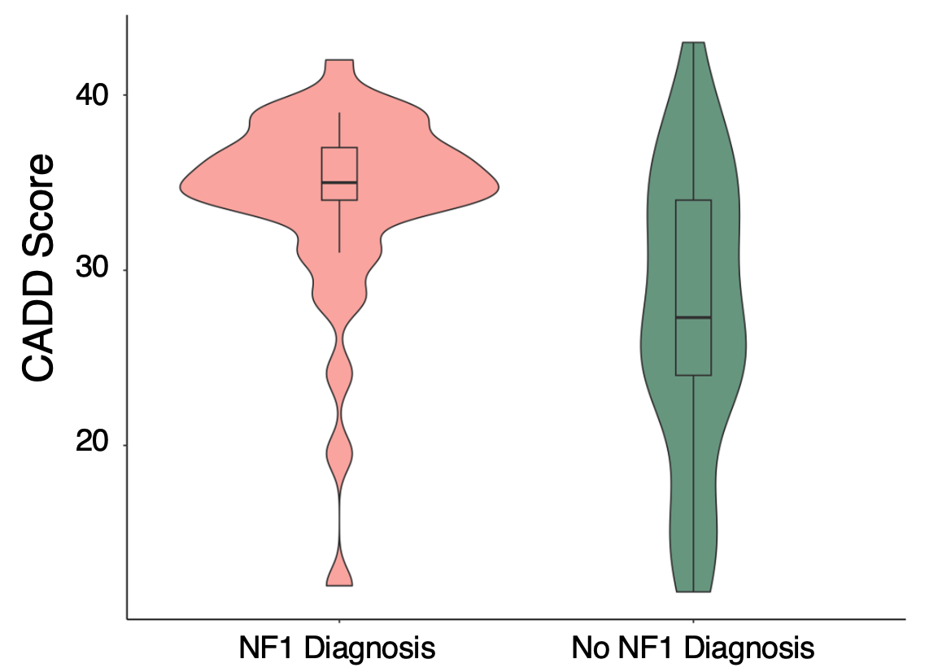
Do variants in diagnosed individuals have a higher biological impact?
p = 0.0002166

Slide 12
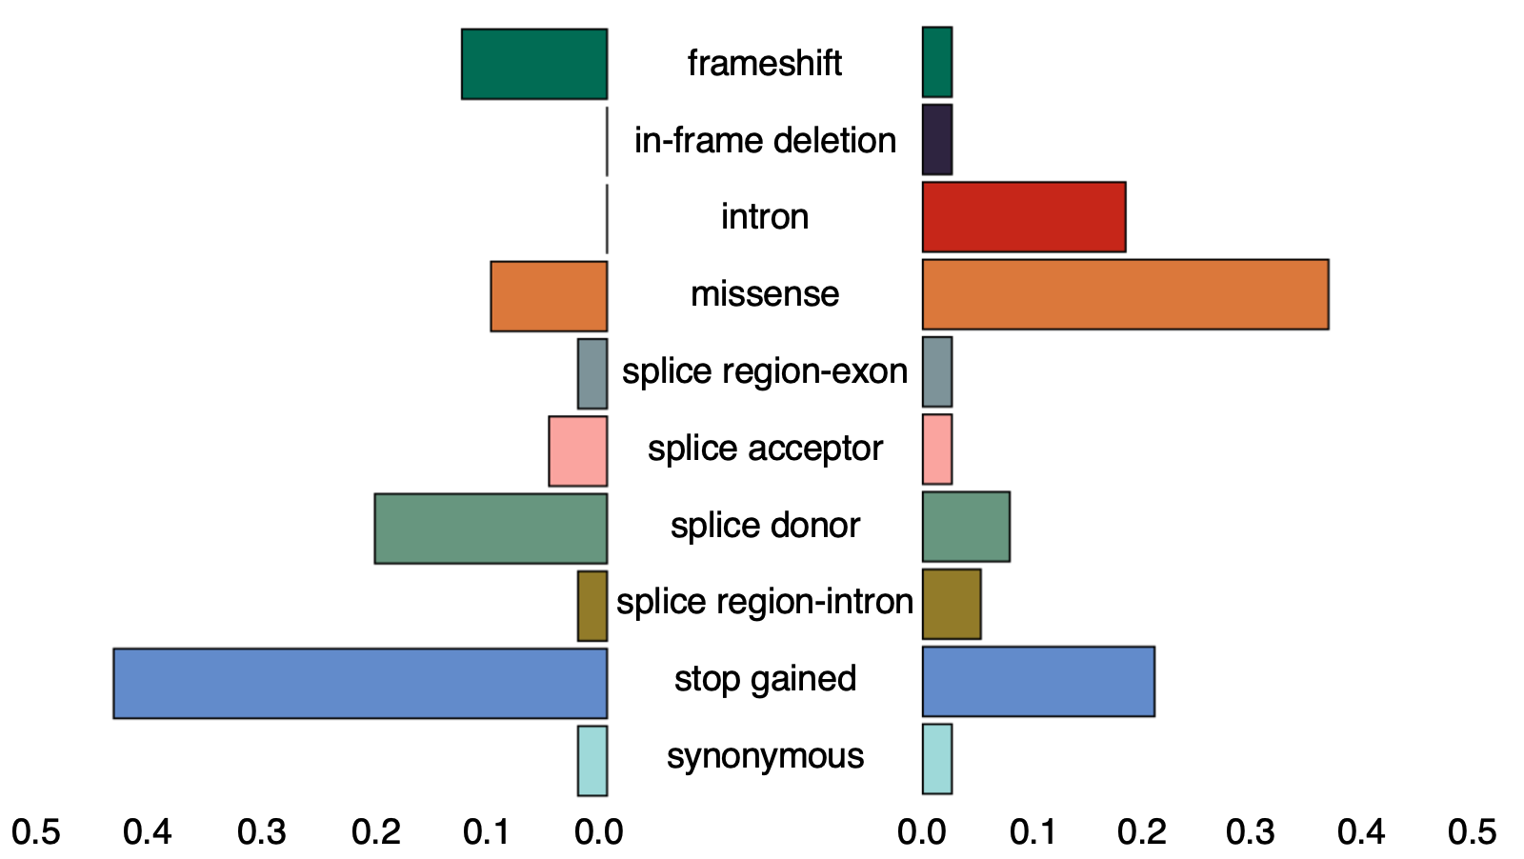
Do variants in diagnosed individuals have a higher biological impact?
Diagnosed with NF1
P/LP NF1 Variation without an
NF1 Diagnosis
p = 0.0009167

Slide 13
Overview
Are the EHR of undiagnosed individuals incomplete?
No. The number of SNOMED CT codes in undiagnosed individual EHR was not different from the average AoURP participant. PheRS in undiagnosed individuals were higher than average AoURP participant.
Are there SDoH differences between diagnosed individuals and undiagnosed individuals?
Yes. The subset of undiagnosed participants had a greater proportions of uninsured, Asian, and male individuals.
Do variants in diagnosed individuals have a higher biological impact?
Yes. Variants in diagnosed individuals had higher CADD scores and more damaging biological consequences.

Slide 14
Conclusions
We found 49% of individuals with pathogenic or likely pathogenic NF1 variants do not have an NF1 diagnosis.
Individuals with with P/LP NF1 variation may be experiencing barriers to diagnosis due to SDoH and additionally represent a different NF1 mutational spectrum than diagnosed individuals.
Notes:
”different mutational spectrum”

Slide 15
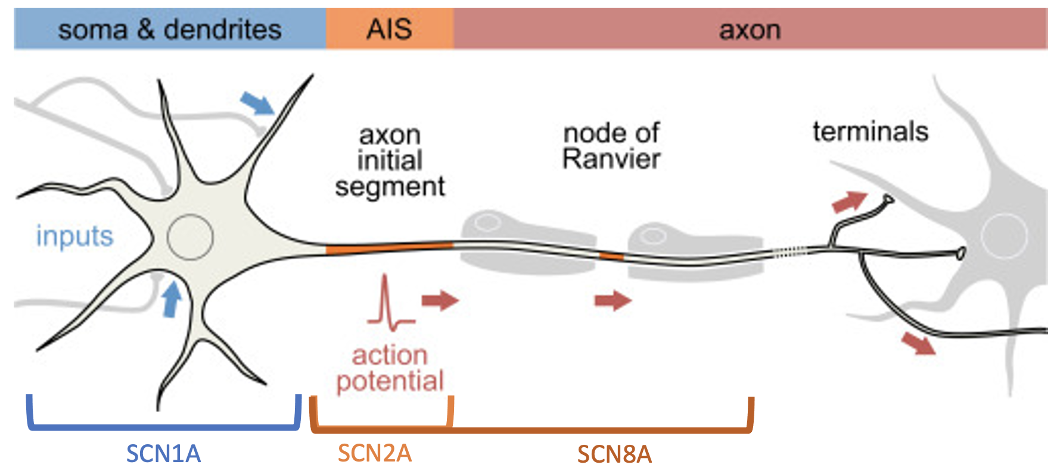

SCNxA: Voltage-gated sodium channel alpha subunits
Meisler and Kearney (2005) Sodium channel mutations in epilepsy and other neurological disorders
Leterrier C. (2016) Chapter Six - The Axon Initial Segment, 50 Years Later: A Nexus for Neuronal Organization and Function

Slide 16
Poison Exon Annotations Improve the Yield of Clinically Relevant Variants in Genomic Diagnostic Testing
Hypothesis:
Introns containing poison exons are a source of pathogenic variation in neurodevelopmental disorders
Project Objective:
Curate a list of hypothetical poison exons from RNA-seq data across developmental time in mouse cortex and screen neurodevelopmental cohorts for potentially pathogenic variants in introns containing poison exons.

Slide 17
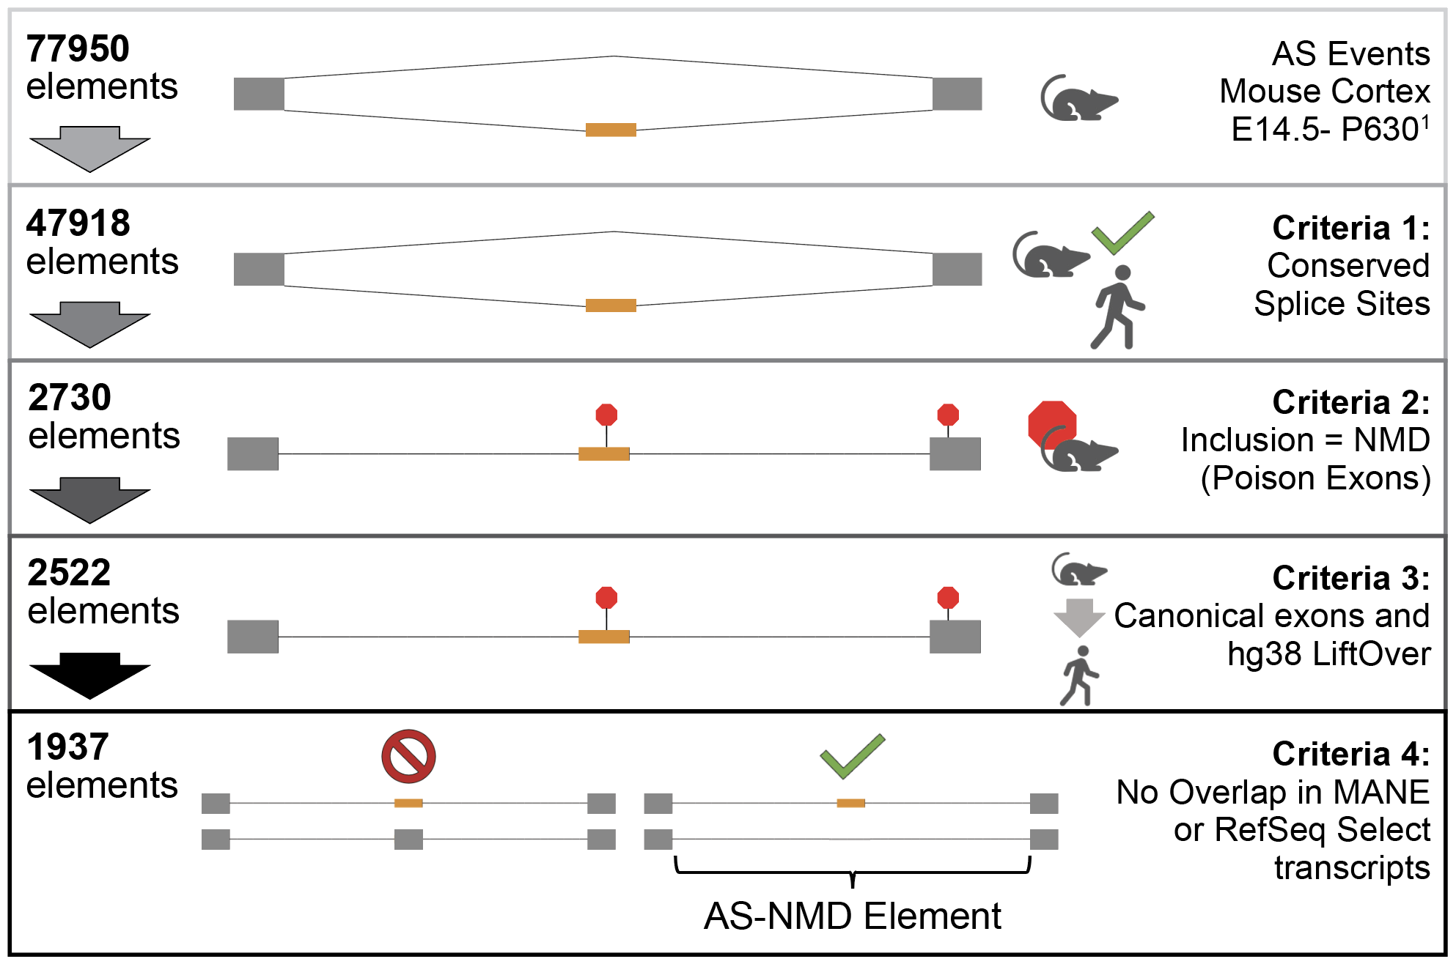
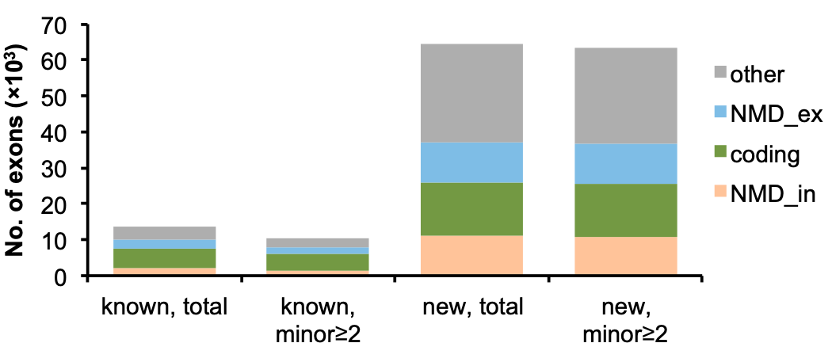
Poison Exon Region Curation
Systematic discovery of alternative exons in Yan et al., 2015

Slide 18
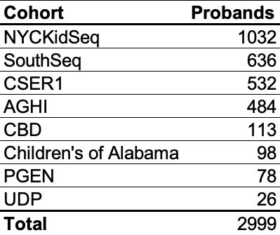


Neurodevelopmental Disorder Cohorts

Slide 19
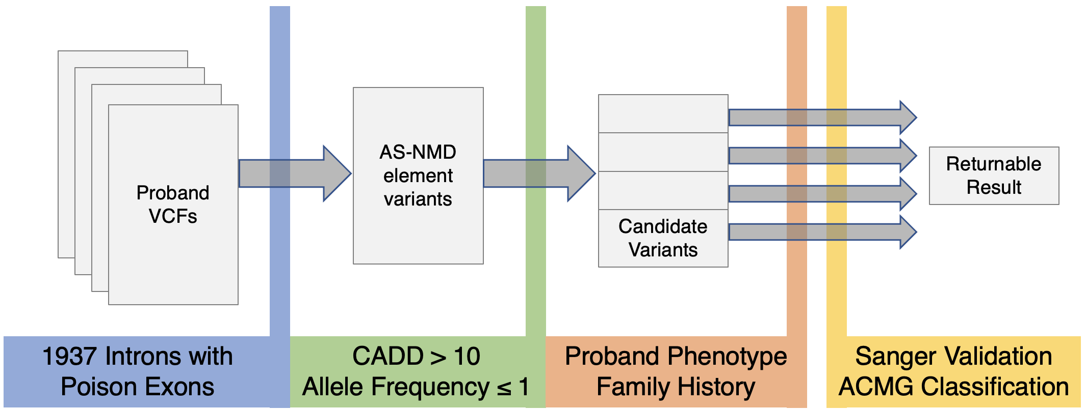
Poison Exon Variant Filtration
Allele Count ≤ 1
Less than one variant per proband

Slide 20
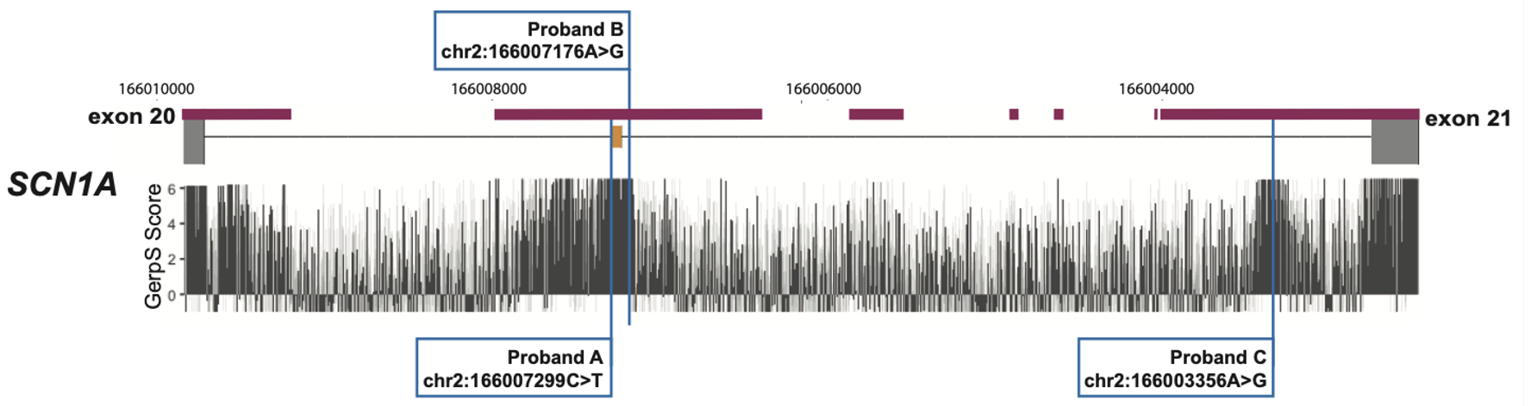
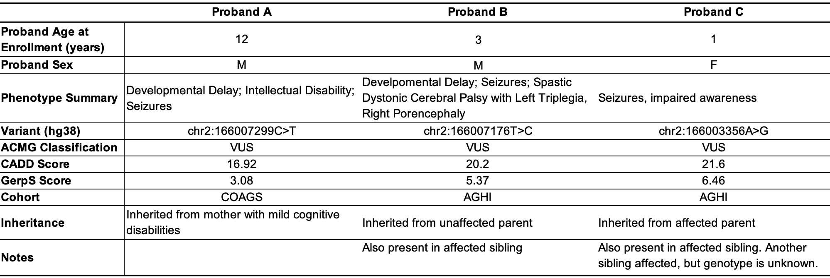
SCN1A Poison Exon Variants

Slide 21
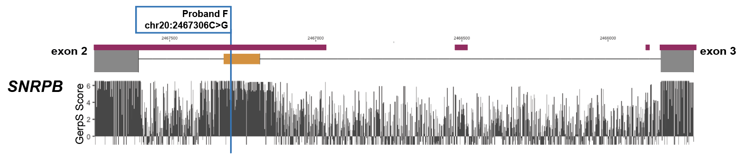
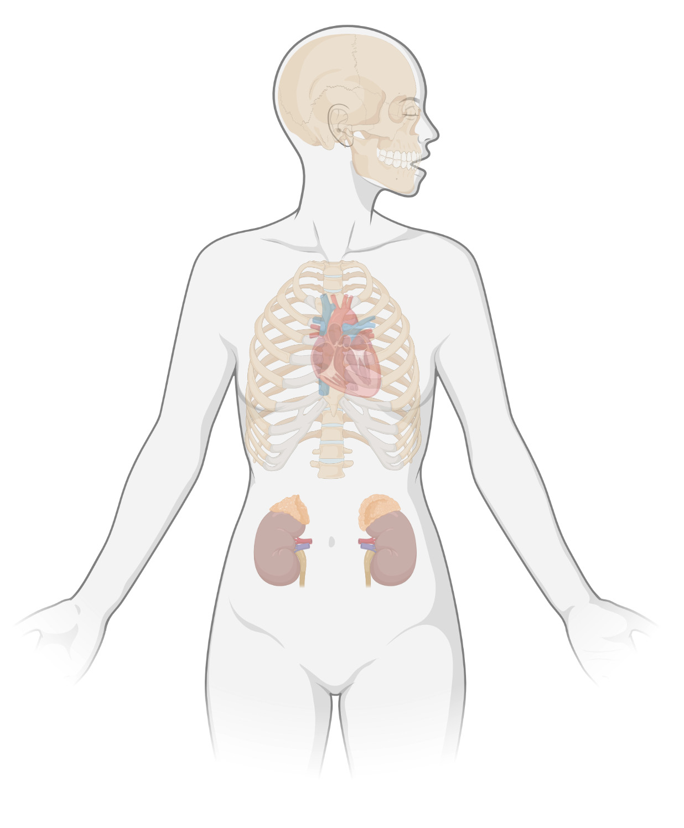
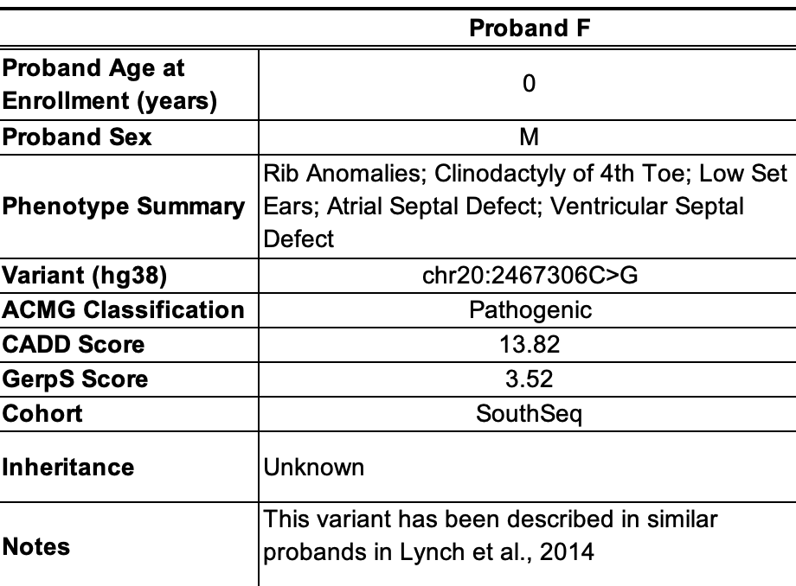
SNRPB Poison Exon Variant
Cerebro–costo–
mandibular syndrome
Intellectual Disability
Microcephaly
Low-Set Ears
Cleft Palate
Micrognathia
Atrial Septal Defect
Ventricular Septal Defect
Rib Malformations
Respiratory Distress
Multicystic Kidney Dysplasia

Slide 22


Acknowledgements
Greg Barsh Lab and Associates
Chris Kaelin
Kelly McGowan
Emily Puckett
Ren Larison
Gopal Battu
Bruce Korf
Hua Tang

